Slide 1
Networking and distributed applications

Slide 2
Motivation…
Implementing reliable software can be a difficult process
Such a process is usually separated into phases to improve detecting errors for each implemented components
Beside errors that are produces by programming the software itself others could be made through configuring or programming the network and infrastructure
In order to detect errors correctly additional knowledge about networking and Infrastructure is needed.

Slide 3
Motivation
Recent development of web applications and the infrastructure around it has implication on the design and the implementation of software
With recent development we mean cloud computing:
Software as a service SaaS (for example webshops)
Platform as a service PaaS (for example a servers)
Infrastructure as a service IaaS (for example hardware)

Slide 4
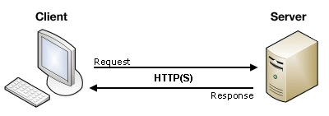
Client server architecture
A distributed application structure is a partition of the tasks or workloads between servers, and service requesters, called clients
A server host runs one or more server programs which share their resources with clients
A client does not share any of its resources, but requests a server's content or service function
Client and server communication is implemented using netwrok protocols. You application must respect the specification of the used protocols.
An example of such used protocols are IP, TCP, UPD, HTTP
We will look closer to some protocols in the following slides.

Slide 5
Networking
A computer network or data network is a telecommunications network which allows computers to exchange data
Data are transmitted as a bit of streams or
as a network packet that is a formatted unit of data (a list of bits or bytes)
Packages are transmitted through a specific physical layer
Layers are characterised through their organisational purpose:
Local area network (LAN) which is usually limited to a building
Wide area network (WAN) which extends over a large geographical distance
Virtual Private network (VPN) which uses tunnelling to connect to another network

Slide 6
Network topologies
A network topologie is a graph structure used to connect/link different nodes to create a network
Nodes could be any hardware components such as hosts, switches, servers, routers, printers etc) that are connected/linked
Every topology shown above has it’s own dis-/advantages
For example in a star topology the fail of the central node breaks the connection completely
Data in the network are transmitted through one or the combination of different topologies

Slide 7
Internet protocol
IP has the task of delivering packets from the source node to the destination node solely based on the IP addresses in the packet headers.
IP also defines addressing methods that are used to label the datagram with source and destination information
IPv4
Since 1981
32 bit
Decimal / 4 groups of 3 digits

Slide 8
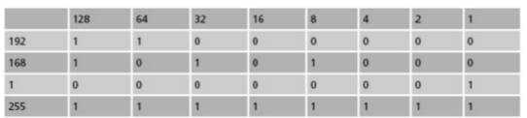
IPv4 sample
Consider having the following private IP address for a machine:
192.168.1.255
The IP address is represented through the following binary code
11000000.10101000.00000001.11111111

Slide 9
Subnet mask
To match physical layout (e.g. Sales, production, etc.)
To match administrative layout (e.g. Managers, staff, etc.)
To plan for growth
To reduce network traffic
Examples
A 255.0.0.0 first byte is fixed
B 255.255.0.0 first two bytes are fixed
C 255.255.255.0 first three bytes are fixed
Subnets are used to determine the address is local or remote

Slide 10
IPv6
128 bit (as mac-addresses of machines)
Hexadecimal (base 16 or hex)
Not interoperable with IPv4
Improves some limitation of IPv4 such as:
Exhausting IPv4 addresses
improve IPv4 routing through changing the package structure
The packet header in IPv6 is simpler than the IPv4 header. Many rarely used fields have been moved to optional header extension
Example FE80:0000:0000:0000:0202:B3FF:FE1E:8329

Slide 11
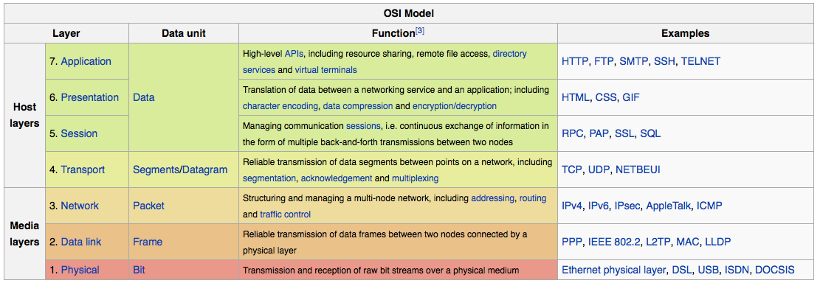
OSI model
Open Systems Interconnection model (OSI model)
It is a conceptual model that characterises and standardises the communication of a telecommunication or computing system
Consist of 7 layers, each layer adds more information to the header of the package that is been sent from a host to another one

Slide 12
Transport layer protocols: UPD vs TCP
User datagram protocol(UDP): UDP uses a simple connectionless transmission model with a minimum of protocol mechanism. It has no handshaking dialogues
Transmission control protocol(TCP): provides reliable, ordered, and error-checked delivery of a stream of octets between applications

Slide 13
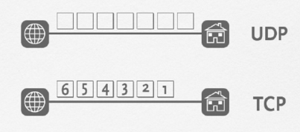
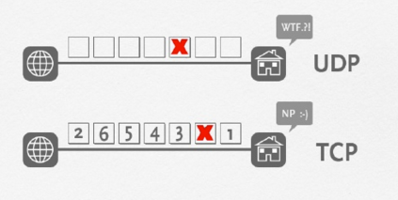
TCP vs. UDP

Slide 14
Common network layers and data flow
Let us look at a typical example of making a a voice over ip (voip call)
A voip call uses typically a UDP connection.
The data flows in the networks starting from host one (A) until it reaches host (B)
It might flow through some routers between host (A) and (B)

Slide 15
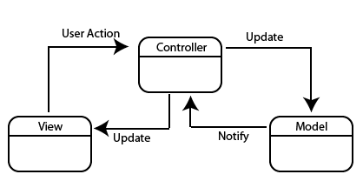
Model-View-Controller (MVC)
It is a architectural design pattern.
Intent: Partition an applications into three parts
- Model
- View
- Controller
• Motivation: Use divide and conquer to simplify among the parts of a program
- Defines the role the objects play in an application into one of three parts
- Defines the way objects communicate with each other

